Slide 1
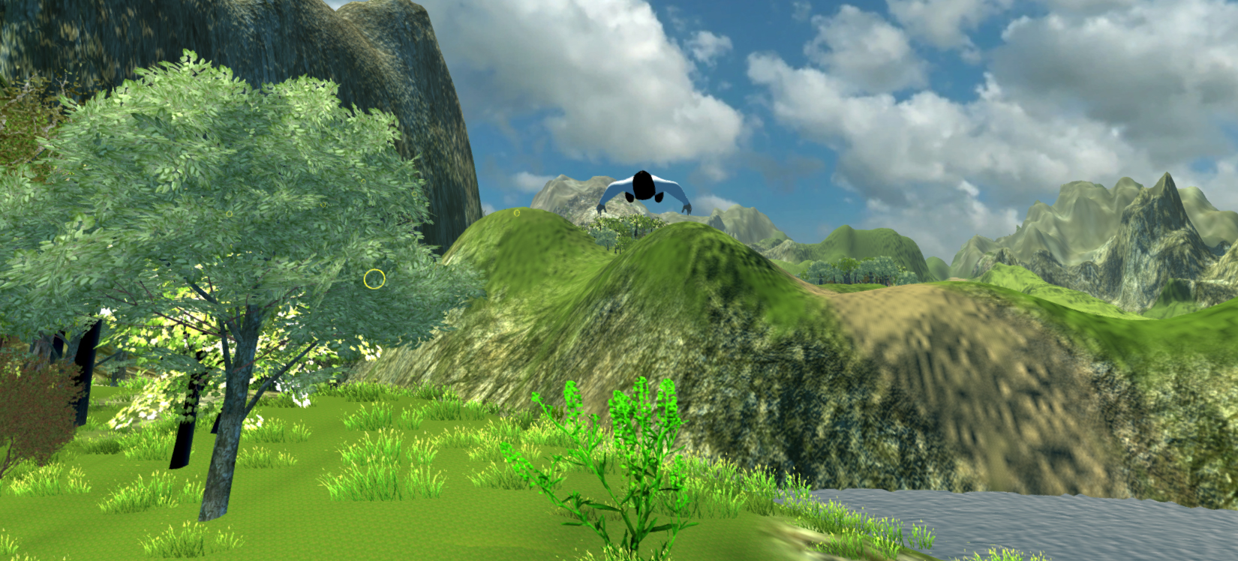
Rift Wingsuit
Sebastian Nickel, Jonas Kleinkauf, Andreas Dietze, Manuel Schmitt, Sascha Ibach

Slide 2
Content
Technical features and updates
New assets and logics
Updated milestones

Slide 3
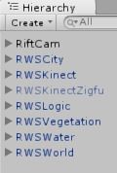
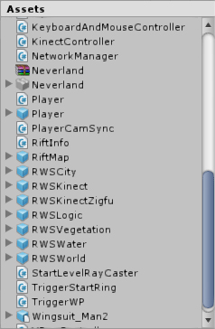
Updates Kinect
Solved Kinect problems
Based onHardware (USB)
New kinect package
Supporting Kinect V1/2
Optimized processing of Kinect outputs
Hierarchy und Prefabs
Notes:
Rotation-Lock-X => Es kann nicht übersteuert werden

Slide 4
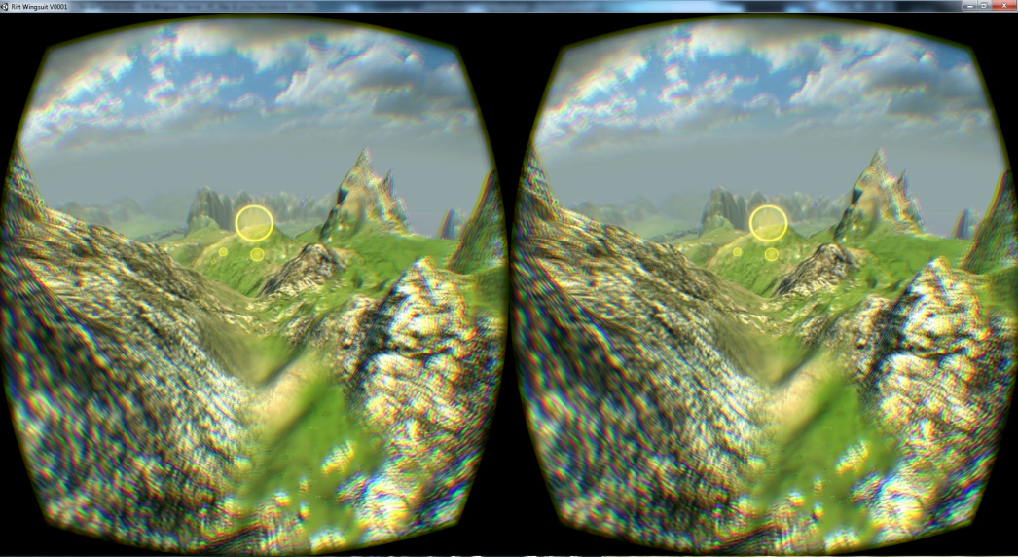
Oculus Rift
Some problems with new SDKs
Search solutions
Re-implementation

Slide 5
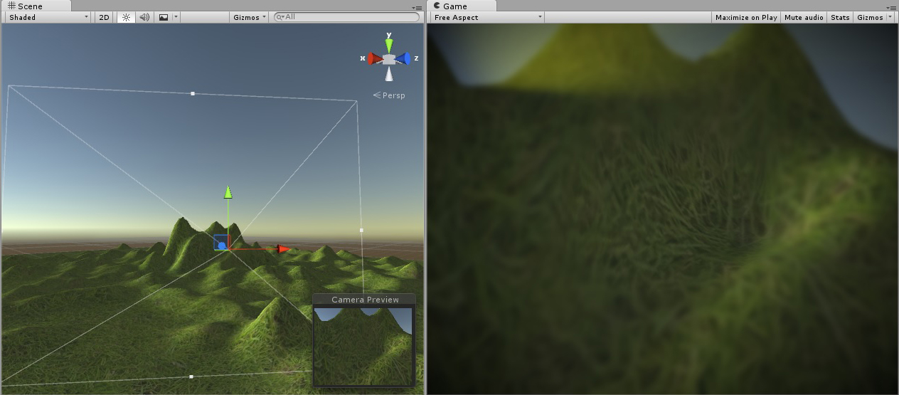
Post Processing

Slide 6
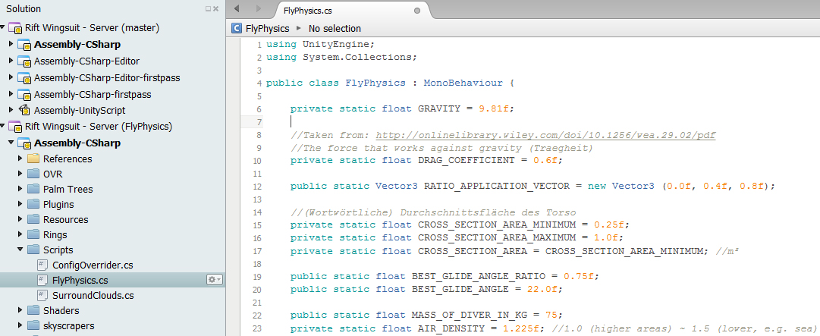
Fly Physics

Slide 7
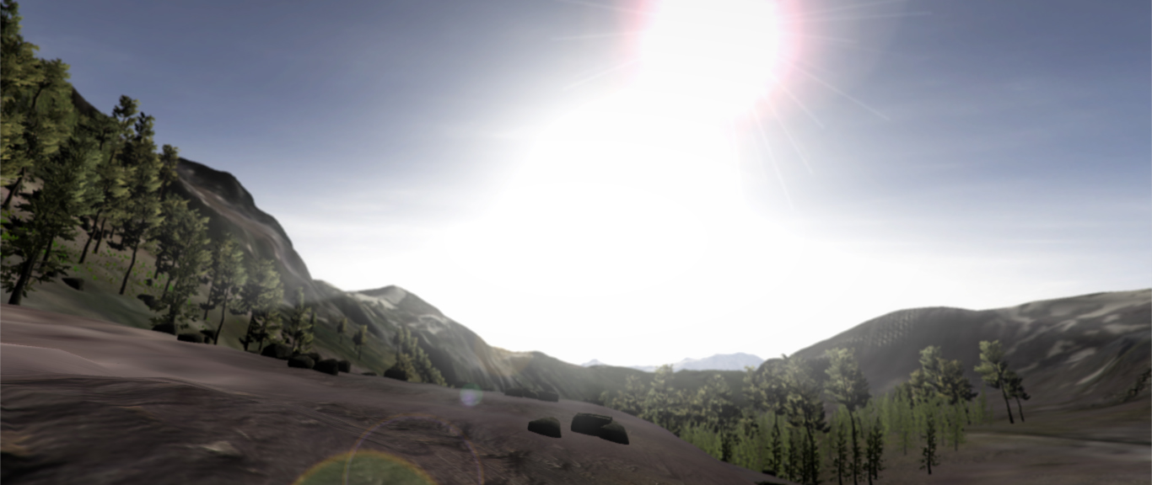
New World

Slide 8
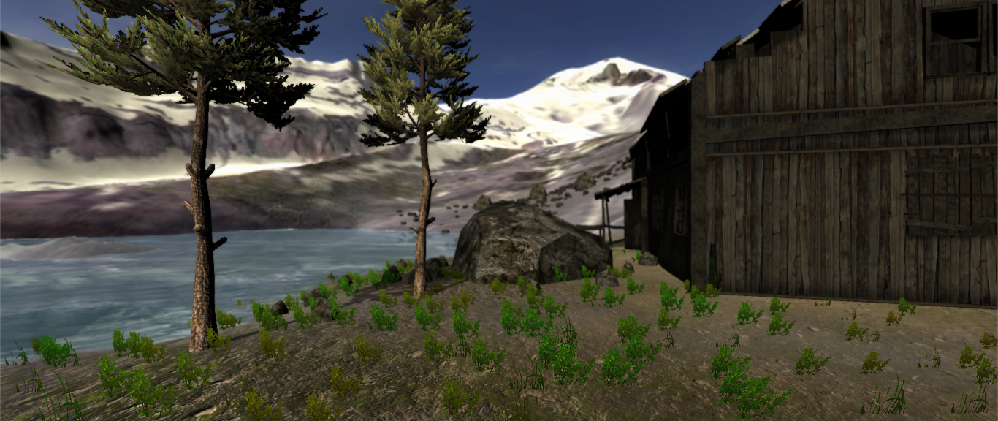
New World

Slide 9
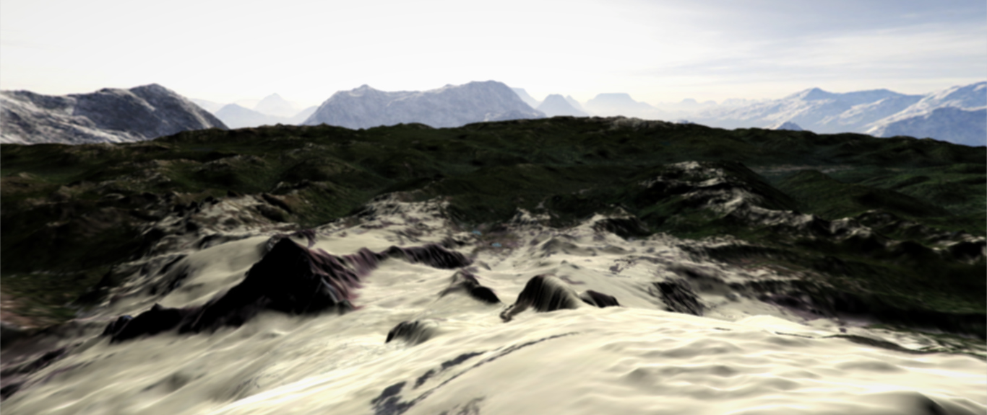
New World

Slide 10
Responsibilities (Assistent)
Oculus DK2 / Vive
Sascha Ibach (A. Dietze)
Kinect V1/V2
Andreas Dietze (S. Nickel)
Flyphysics
Sebastian Nickel (A. Dietze)
Player model
Jonas Kleinkauf (S. Ibach)
World and ambiance
Jonas Kleinkauf (M. Schmitt)
Post processing
Manuel Schmitt (J.K., S.N.)
Audio
Jonas Kleinkauf (A. Dietze)
Menues
Manuel Schmitt (S.N., S.I.)
Gamelogics
Jonas Kleinkauf (Comp. Grp.)
Documentation and User Guide
Andreas Dietze (M.S., S.I.)
Simplified handling
Sascha Ibach (A. Dietze)

Slide 11
Milestone One (old)
Week | Andras Dietze | Sebastian Nickel | Jonas Kleinkauf | Manuel Schmitt | Sascha Ibach
05.12 – 05.19 | Clean up, git Kinect V2 Old state | Laws of aerodynamics | Terrain optimization Terrain generation | Working into the project and Unity Engine | Working into the project and Unity Engine
05.19 – 05.26 | Setup 06.10 Setup impr. New world assets | First model based on real physic laws | Obstacles Collision, Bonus Items, Updrafts | Creation of post-processing effects like bloom and blur | Working into Oculus and possible improvements
05.26 – 06.02 | Setup 06.10 Vive integr. (visula) | Continuing work on the flying physics model | NewLevel Creation using Terrain Generators | Creation of ambient-occlusion-light -map | Oculus improvements (Menu, …)

Slide 12
Milestone One (updated)
Week | Andras Dietze | Sebastian Nickel | Jonas Kleinkauf | Manuel Schmitt | Sascha Ibach
05.12 – 05.19 | Clean up, git Kinect V2 Old state | Laws of aerodynamics | Terrain optimization Terrain generation | Working into the project and Unity Engine | Working into the project and Unity Engine
05.19 – 05.26 | Kinect V1/2 Setup impr. | First model based on real physic laws | Obstacles Collision, Bonus Items, Updrafts | Creation of post-processing effects like bloom and blur (sunshafts, vignette) | Working into the project and Unity Engine Kinect V1/V2
05.26 – 06.02 | Kinect V1/2 (getting crazy) | Continuing work on the flying physics model | NewLevel Creation using Terrain Generators | Working into shader prog. to create own shaders like radial blur | Kinect V1/2 Gameplay, Parachute landing

Slide 13
Milestone Two (old)
Week | Andras Dietze | Sebastian Nickel | Jonas Kleinkauf | Manuel Schmitt | Sascha Ibach
06.02 – 06.09 | Vive inter. (haptic) Kinect impr. Balancing new features | Improve fly-physics model Error tolerance | Level Design, Programming Obstacle Placement, Player Path | Buffer for ao God-rays and/or atmos. scattering | Server-menue Oculus Shader-menue and controls
06.09 – 06.16 | Vive location setup, impr. Fly physics Doc | Add configuratable properties to flying-model | Secrets Collectibles World Refinement | Client-menu-structure Menue functionality | Game Interaction / - Logic / -Flow (Parachute landing, …)
06.16 – 06.23 | Fly physics Doc User Guide | Through testing of the flying physics | Player Model Rigging Texturing | Menue funct. Gamepad support | Buffer for GameLogic Playermodel

Slide 14
Milestone Two (updated)
Week | Andras Dietze | Sebastian Nickel | Jonas Kleinkauf | Manuel Schmitt | Sascha Ibach
06.02 – 06.09 | Implem. new Kinect package Kinect V1/2 stable config Flight impr. | Improve fly-physics model Configurable Bugfixed fly-physics issues | Secrets Collectibles World Refinement | Working into shaders Testing SSAO Kinect tests | Gameplay, Parachute landing Working into Oculus and possible improvements
06.09 – 06.16 | Flight impr. Oculus setup Setup 06.10 | Bugfixing Error handling | Integration World + Game objects by project team | Working into shaders Configuring spectator functions | Oculus setup Setup 06.10 Oculus Reintegration
06.16 – 06.23 | Vive integr. tests ☺ Fly physics support | Thorough Fly-Physics tests | Obstacle Placement, Player Path | Menue funct. Gamepad support | Oculus Reintegration / Shader-menu and controls Server-menu

Slide 15
Exams
16.07.2016 - 30.07.2016 and 12.09.2016 - 24.09.2016
Exam and preperation 23.06 - 30.07
Sec. exam phase -> individual schedule

Slide 16
Milestone Three (old)
Week | Andras Dietze | Sebastian Nickel | Jonas Kleinkauf | Manuel Schmitt | Sascha Ibach
08.01 – 08.08 | Fly physics User Guide Doc | Evaluation of open-source KinectV2 driver | Player Model Animations with User Input | User guide support | User guide (client)
08.08 – 08.16 | Client cam Client audio Client handl. | Assisting with the menu struct. e.g.: possible improvements | Integration World + Game objects by project team | Documen-tation support | Documen-tation (client)
08.16 – 24.08 | Client improvement buffer | Buffer; Overall testing („Bug hunting“) | Background Music and Sound Effects | Buffer for any relevant work | Buffer for any relevant work
08.24 – 09.14 | Buffer (fly physics, game logics, …) | Buffer (fly physics, game logics, assistant) | Buffer (fly physics, game logics, assistant) | Buffer for any relevant work | Buffer for any relevant work

Slide 17
Milestone Three (updated)
Week | Andras Dietze | Sebastian Nickel | Jonas Kleinkauf | Manuel Schmitt | Sascha Ibach
08.01 – 08.08 | Doc User Guide Client impr. | Assisting with the menu struct. e.g.: possible improvements | Player Model Animations with User Input | User guide support | Game Logic / Parachute landing Buffer Player Model
08.08 – 08.16 | Client cam Client audio Client handl. | „The helping hand for emergencies“ |  | Documen-tation support | User Guide (client) Documen-tation (client)
08.16 – 24.08 | Client improvement buffer | Buffer; Overall testing („Bug hunting“) | Background Music and Sound Effects | Buffer for any relevant work | Buffer for any relevant work
08.24 – 09.14 | Buffer (fly physics, game logics, ..) | Buffer (fly physics, game logics, assistant) | Buffer (fly physics, game logics, assistant) | Buffer for any relevant work | Buffer for any relevant work

Slide 18
Github Version Control
Old project source
https://github.com/andreasdietze/Rift-Wingsuit.git
New project source
https://github.com/andreasdietze/Rift-WingsuitV2.git

Slide 19
Thanks for your attention ☺

